Slide 1
Game Playing
Notes:
‹#›
‹#›

Slide 2
What kind of games?
Abstraction: To describe a game we must capture every relevant aspect of the game. Such as:
Chess
Tic-tac-toe
…
Accessible environments: Such games are characterized by perfect information
Search: game-playing then consists of a search through possible game positions
Unpredictable opponent: introduces uncertainty thus game-playing must deal with contingency problems
Notes:
‹#›

Slide 3
Improving effectiveness
To improve the effectiveness of a search-based problem-solving program two things can be done:
Improve the generate procedure so that only good moves (or paths) are generated
Improve the test procedure so that the best moves (or paths) will be recognized and explored first
Notes:
‹#›

Slide 4
Searching for the next move
Complexity: many games have a huge search space
Chess: b = 35, m=100 ⇒ nodes = 35 ¹⁰⁰
Resource (e.g., time, memory) limit: optimal solution not feasible/possible, thus must approximate
Pruning: makes the search more efficient by discarding portions of the search tree that cannot improve quality result.
Evaluation functions: heuristics to evaluate utility of a state without exhaustive search.
‹#›
Notes:
‹#›

Slide 5
Static Evaluation Function
In the amount of time available, it is usually possible to search a tree only ten or twenty moves deep (called ply).
Then in order to choose the best move, the resulting board positions must be compared to discover which is most advantageous.
This is done using a static evaluation function, which uses whatever information it has to evaluate individual board positions by estimating how much likely they are to lead eventually to a win
Notes:
‹#›

Slide 6
Two-player games
A game formulated as a search problem:
Initial state: ?
Operators: ?
Terminal state: ?
Utility function: ?
(payoff function)
Notes:
‹#›

Slide 7
Two-player games
A game formulated as a search problem:
Initial state: board position and turn
Operators: definition of legal moves
Terminal state: conditions for when game is over
Utility function: a numeric value that describes the outcome of the (payoff function) game. E.g., -1, 0, 1 for loss, draw, win.
Notes:
‹#›

Slide 8
Mini Max search Procedure
For a simple one person game or puzzle, the A* algorithm can be used.
It can be applied to reason forward from the current state as far as possible in the time allotted.
But because of their adversarial nature, this procedure is inadequate for 2-person games such as chess.
As values are pushed back up different assumptions must be made at levels where the program chooses the move and at the alternating levels where the opponent chooses
Notes:
‹#›

Slide 9
Mini Max
The mini max search procedure is a depth-first, depth-limited search procedure.
The idea is to start at the current position and use the plausible-move generator to generate the set of possible successor positions.
Now we can apply the “static evaluation function” to those positions and simply choose the best one.
After doing so, we can back up the value to the starting position to represent our evaluation of it.
Notes:
‹#›

Slide 10
The minimax algorithm
Perfect play for deterministic environments with perfect information
Algorithm:
Generate game tree completely
Determine utility of each terminal state
Propagate the utility values upward in the tree by applying MIN and MAX operators on the nodes in the current level
At the root node use minimax decision to select the move with the max (of the min) utility value
Steps 2 and 3 in the algorithm assume that the opponent will play perfectly.
Notes:
‹#›

Slide 11
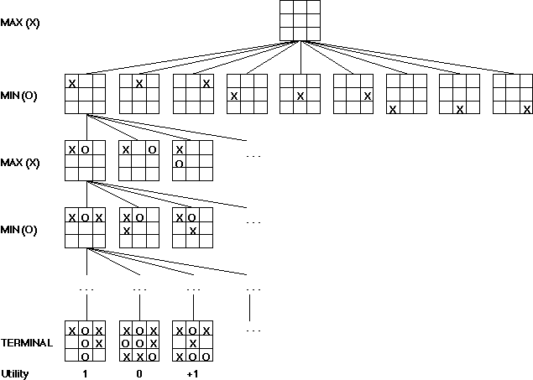
Partial Game Tree for Tic-Tac-Toe
f(n) = +1 if the position is a win for X.
f(n) = -1 if the position is a win for O.
f(n) = 0 if the position is a draw.
Notes:
‹#›
‹#›

Slide 12
Generate Game Tree
Notes:
‹#›

Slide 13
Generate Game Tree
x
x
 | x
 |  | x
Notes:
‹#›

Slide 14
Generate Game Tree
 | x
 | x | o
 | x
 | o
o | x
 | x
o
Notes:
‹#›

Slide 15
Generate Game Tree
 | x
1 ply
1 move
 | x | o
 | x
 | o
o | x
 | x
o
Notes:
‹#›

Slide 16
Minimax
3
12
8
2
4
6
14
5
2
Minimize opponent’s chance
Maximize your chance
Notes:
‹#›

Slide 17
Minimax
3
2
2
MIN
3
12
8
2
4
6
14
5
2
Minimize opponent’s chance
Maximize your chance
Notes:
‹#›

Slide 18
Minimax
3
MAX
3
2
2
MIN
3
12
8
2
4
6
14
5
2
Minimize opponent’s chance
Maximize your chance
Notes:
‹#›

Slide 19
Minimax
3
MAX
3
2
2
MIN
3
12
8
2
4
6
14
5
2
Minimize opponent’s chance
Maximize your chance
Notes:
‹#›

Slide 20
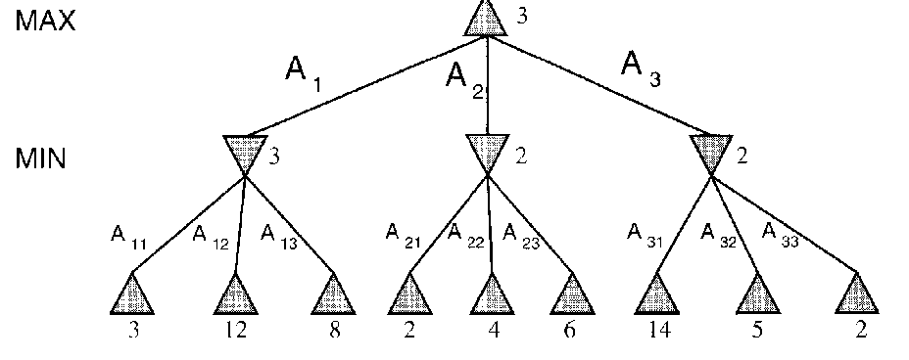
minimax = maximum of the minimum
1st ply
2nd ply
Notes:
‹#›

Slide 21
Mini Max Example
A ?
B ?
C ?
D ?
E 9
F -6
G 0
H 0
I -2
J -4
K -3
Notes:
‹#›

Slide 22
Mini Max Example
A ?
B -6
C -2
D -4
E 9
F -6
G 0
H 0
I -2
J -4
K -3
Notes:
‹#›

Slide 23
Mini Max Example
A -2
B -6
C -2
D -4
E 9
F -6
G 0
H 0
I -2
J -4
K -3
Notes:
‹#›

Slide 24
Minimax search example Minimax Tree
MAX
4
MIN
4
2
4
8
2
14
4
2
6
8
1
2
12
14
4
5
3
2
6
7
8
9
1
10
2
11
12
13
14
14
Notes:
‹#›

Slide 25
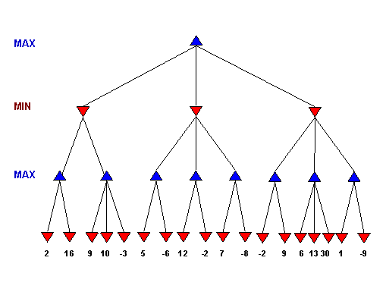
Notes:
‹#›

Slide 26
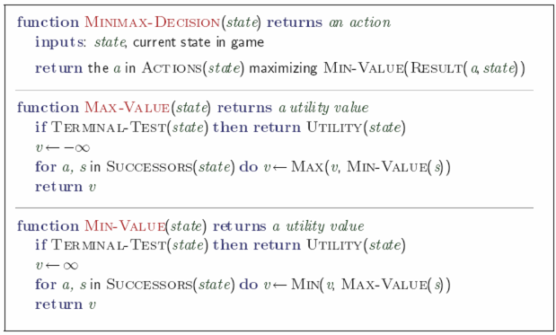
Minimax: Recursive implementation
Complete: Yes, for finite state-space Optimal: Yes
Time complexity: O(b^{m}) Space complexity: O(bm) (= DFS Does not keep all nodes in memory.)
Notes:
‹#›

Slide 27
Move evaluation without complete search
Complete search is too complex and impractical
Evaluation function: evaluates value of state using heuristics and cuts off search
New MINIMAX:
CUTOFF-TEST: cutoff test to replace the termination condition (e.g., deadline, depth-limit, etc.)
EVAL: evaluation function to replace utility function (e.g., number of chess pieces taken)
Notes:
‹#›
‹#›

Slide 28
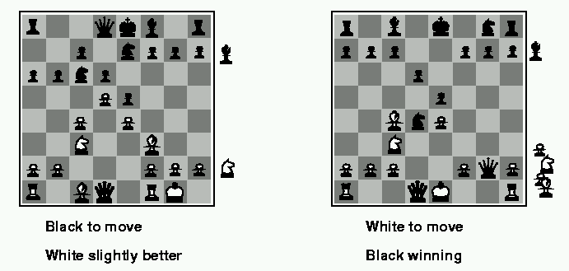
Evaluation functions
Weighted linear evaluation function: to combine n heuristics f = w₁f₁ ₊ w₂f_{2 + … +} w_{n}f_{n}
E.g, w’s could be the values of pieces (1 for prawn, 3 for bishop etc.) f’s could be the number of type of pieces on the board
Notes:
‹#›

Slide 29
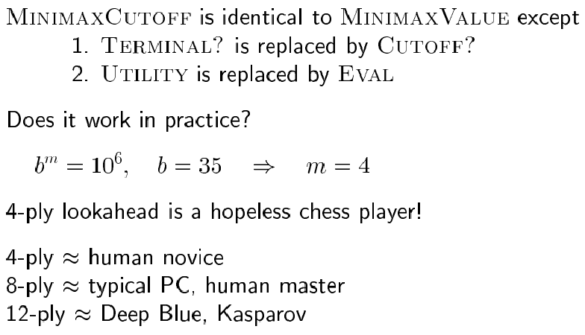
Minimax with cutoff: viable algorithm?
Notes:
‹#›

Slide 30
Search with an opponent
Heuristic approximation: defining an evaluation function which indicates how close a state is from a winning (or losing) move
This function includes domain information.
It does not represent a cost or a distance in steps.
Conventionally:
A winning move is represented by the value“+∞”.
A losing move is represented by the value “-∞”.
The algorithm searches with limited depth.
Each new decision implies repeating part of the search.
Notes:
‹#›
‹#›

Slide 31
Example: tic-tac-toe
e (evaluation function → integer) = number of available rows, columns, diagonals for MAX - number of available rows, columns, diagonals for MIN
MAX plays with “X” and desires maximizing e.
MIN plays with “0” and desires minimizing e.
Symmetries are taken into account.
A depth limit is used (2, in the example).
Notes:
‹#›
‹#›

Slide 32
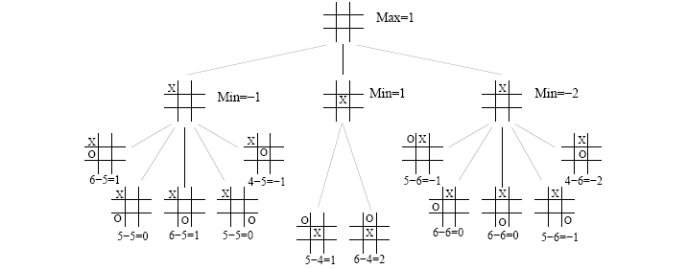
Example: tic-tac-toe
Notes:
‹#›
‹#›

Slide 33
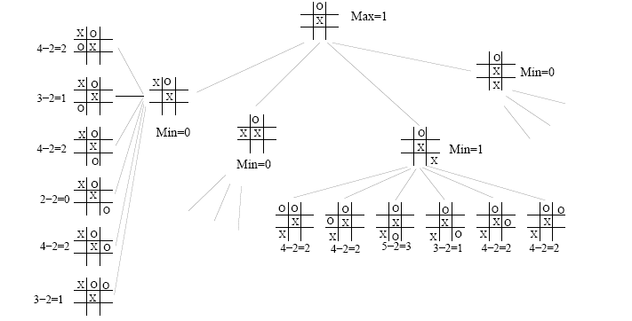
Example: tic-tac-toe
Notes:
‹#›
‹#›

Slide 34
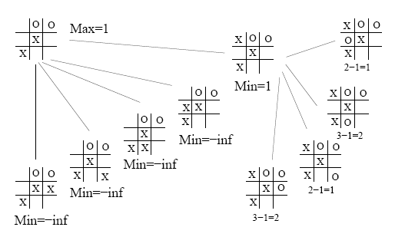
Example: tic-tac-toe
Notes:
‹#›
‹#›

Slide 35
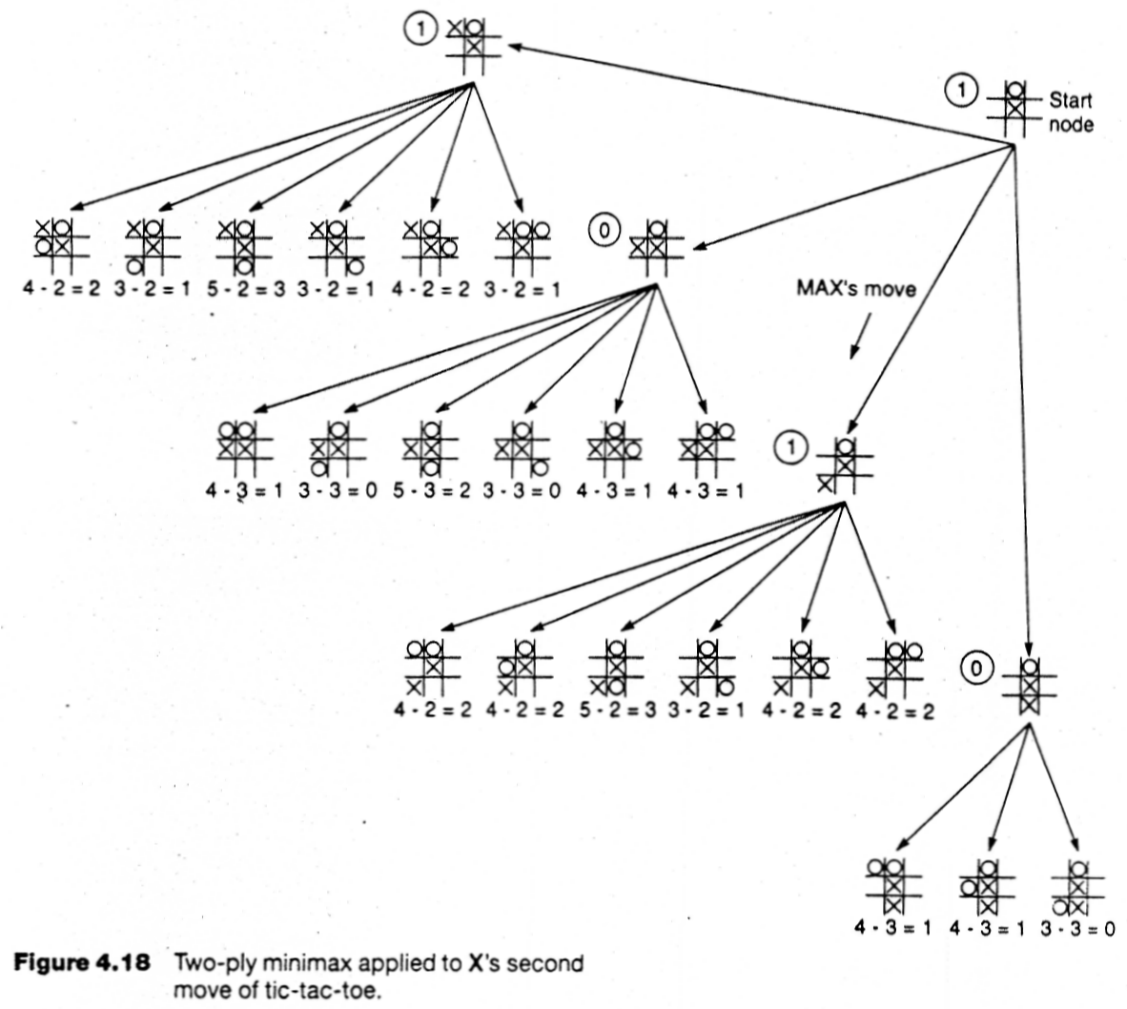
Notes:
‹#›

Slide 36
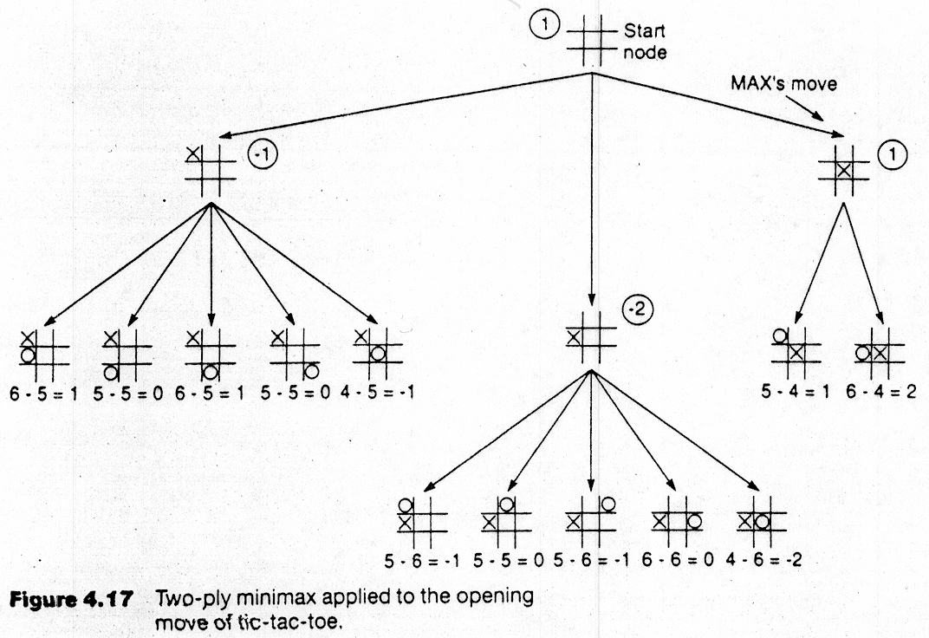
Backup Values
Notes:
‹#›

Slide 37
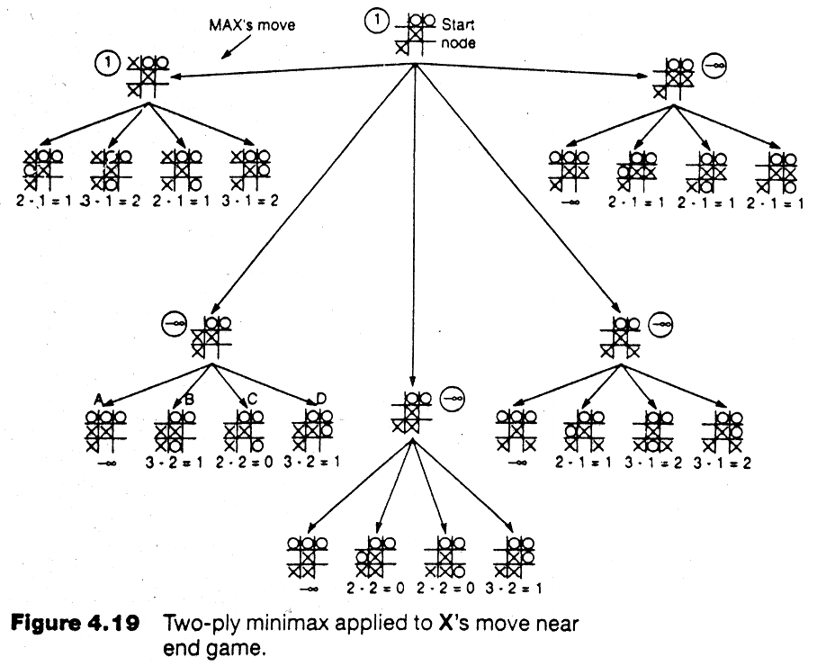
Notes:
‹#›

Slide 38
The minimax algorithm
The minimax algorithm computes the minimax decision from the current state.
It uses a simple recursive computation of the minimax values of each successor state:
directly implementing the defining equations.
The recursion proceeds all the way down to the leaves of the tree.
Then the minimax values are backed up through the tree as the recursion unwinds.
‹#›
‹#›
Notes:
‹#›
‹#›

Slide 39
Example
Coins game
There is a stack of N coins
In turn, players take 1, 2, or 3 coins from the stack
The player who takes the last coin loses
Notes:
‹#›

Slide 40
Coins Game: Formal Definition
Initial State: The number of coins in the stack
Operators:
1. Remove one coin
2. Remove two coins
3. Remove three coins
Terminal Test: There are no coins left on the stack
Utility Function: F(S)
F(S) = 1 if MAX wins, 0 if MIN wins
Notes:
‹#›

Slide 41
MAX
MIN
N = 4
K =
1
3
2
N = 3
K =
N = 2
K =
N = 1
K =
1
3
2
2
1
1
N = 0
K =
N = 1
K =
N = 2
K =
N = 0
K =
N = 1
K =
N = 0
K =
F(S)=1
1
1
2
F(S)=1
1
F(S)=1
N = 0
K =
N = 1
K =
N = 0
K =
N = 0
K =
F(S)=0
1
F(S)=0
F(S)=0
N = 0
K =
F(S)=1
Notes:
‹#›

Slide 42
MAX
MIN
N = 4
K = 1
Solution
1
3
2
N = 3
K = 0
N = 2
K = 0
N = 1
K = 1
1
3
2
2
1
1
N = 0
K = 1
N = 1
K = 0
N = 2
K = 1
N = 0
K = 1
N = 1
K = 0
N = 0
K = 1
F(S)=1
1
1
2
F(S)=1
1
F(S)=1
N = 0
K = 0
N = 1
K = 1
N = 0
K = 0
N = 0
K = 0
F(S)=0
1
F(S)=0
F(S)=0
N = 0
K = 1
F(S)=1
Notes:
‹#›

Slide 43
α-β pruning: search cutoff
Pruning: eliminating a branch of the search tree from consideration without exhaustive examination of each node
α-β pruning: the basic idea is to prune portions of the search tree that cannot improve the utility value of the max or min node, by just considering the values of nodes seen so far.
Does it work? Yes, in roughly cuts the branching factor from b to √b resulting in double as far look-ahead than pure minimax
Notes:
‹#›

Slide 44
α-β pruning: example
≥ 6
MAX
MIN
6
6
12
8
Notes:
‹#›

Slide 45
α-β pruning: example
≥ 6
MAX
MIN
6
≤ 2
6
12
8
2
Notes:
‹#›

Slide 46
α-β pruning: example
≥ 6
MAX
MIN
6
≤ 2
≤ 5
6
12
8
2
5
Notes:
‹#›

Slide 47
α-β pruning: example
≥ 6
MAX
Selected move
MIN
6
≤ 2
≤ 5
6
12
8
2
5
Notes:
‹#›

Slide 48
α-β pruning: example 2
≥ 3
MAX
MIN
3
3
12
8
Notes:
‹#›

Slide 49
α-β pruning: example 2
≥3
MAX
MIN
3
≤ 2
3
12
8
2
Notes:
‹#›

Slide 50
α-β pruning: example 2
≥ 3
MAX
MIN
3
≤ 2
≤ 14
3
12
8
2
14
Notes:
‹#›

Slide 51
α-β pruning: example 2
≥ 3
MAX
MIN
3
≤ 2
≤ 14 ≤ 5
3
12
8
2
14
5
Notes:
‹#›

Slide 52
α-β pruning: example 2
≥ 3
MAX
MIN
3
≤ 2
≤ 14 ≤ 5 ≤ 2
3
12
8
2
14
5
2
Notes:
‹#›

Slide 53
α-β pruning: example 2
3
MAX
MIN
3
≤ 2
≤ 14 ≤ 5 ≤ 2
3
12
8
2
14
5
2
Notes:
‹#›

Slide 54
α-β pruning: example 2
3
MAX
Selected move
MIN
3
≤ 2
≤ 14 ≤ 5 ≤ 2
3
12
8
2
14
5
2
Notes:
‹#›

Slide 55
Alpha-Beta Pruning Example α Pruning node>= β β Pruning node<= α
a
4
b
4
m
2
c
4
i
n
<=2
>=6
d
4
g
<=3
j
6
o
<=1
q
<=2
MAX
4
5
3
6
7
1
2
e
f
h
k
l
p
r
MIN
Notes:
‹#›

Slide 56
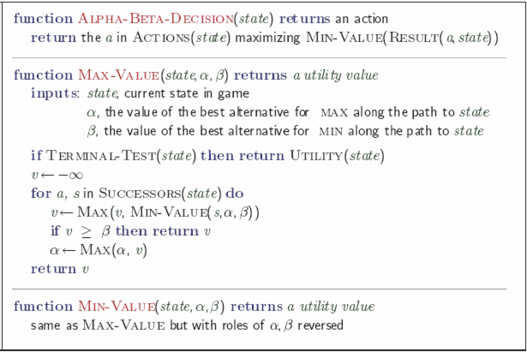
Notes:
‹#›

Slide 57
α-β pruning: example 3 α Pruning node>= β β Pruning node<= α
MAX
MIN
0
5
-3
3
3
-3
0
2
-2
3
5
2
5
-5
0
1
5
1
-3
0
-5
5
-3
3
2
Notes:
‹#›
‹#›

Slide 58
α-β pruning: example 3 α Pruning node>= β β Pruning node<= α
MAX
MIN
0
0
5
-3
3
3
-3
0
2
-2
3
5
2
5
-5
0
1
5
1
-3
0
-5
5
-3
3
2
Notes:
‹#›
‹#›

Slide 59
α-β pruning: example 3 α Pruning node>= β β Pruning node<= α
MAX
MIN
0
0
0
5
-3
3
3
-3
0
2
-2
3
5
2
5
-5
0
1
5
1
-3
0
-5
5
-3
3
2
Notes:
‹#›
‹#›

Slide 60
α-β pruning: example 3 α Pruning node>= β β Pruning node<= α
MAX
MIN
0
0
-3
0
5
-3
3
3
-3
0
2
-2
3
5
2
5
-5
0
1
5
1
-3
0
-5
5
-3
3
2
Notes:
‹#›
‹#›

Slide 61
α-β pruning: example 3 α Pruning node>= β β Pruning node<= α
MAX
MIN
0
0
-3
0
5
-3
3
3
-3
0
2
-2
3
5
2
5
-5
0
1
5
1
-3
0
-5
5
-3
3
2
Notes:
‹#›
‹#›

Slide 62
α-β pruning: example 3 α Pruning node>= β β Pruning node<= α
MAX
MIN
0
0
0
-3
0
5
-3
3
3
-3
0
2
-2
3
5
2
5
-5
0
1
5
1
-3
0
-5
5
-3
3
2
Notes:
‹#›
‹#›

Slide 63
α-β pruning: example 3 α Pruning node>= β β Pruning node<= α
MAX
MIN
0
0
3
0
-3
3
0
5
-3
3
3
-3
0
2
-2
3
5
2
5
-5
0
1
5
1
-3
0
-5
5
-3
3
2
Notes:
‹#›
‹#›

Slide 64
α-β pruning: example 3 α Pruning node>= β β Pruning node<= α
MAX
MIN
0
0
3
0
-3
3
0
5
-3
3
3
-3
0
2
-2
3
5
2
5
-5
0
1
5
1
-3
0
-5
5
-3
3
2
Notes:
‹#›
‹#›

Slide 65
α-β pruning: example 3 α Pruning node>= β β Pruning node<= α
MAX
MIN
0
0
0
0
3
0
-3
3
0
5
-3
3
3
-3
0
2
-2
3
5
2
5
-5
0
1
5
1
-3
0
-5
5
-3
3
2
Notes:
‹#›
‹#›

Slide 66
α-β pruning: example 3 α Pruning node>= β β Pruning node<= α
MAX
MIN
0
0
0
0
3
0
-3
3
5
0
5
-3
3
3
-3
0
2
-2
3
5
2
5
-5
0
1
5
1
-3
0
-5
5
-3
3
2
Notes:
‹#›
‹#›

Slide 67
α-β pruning: example 3 α Pruning node>= β β Pruning node<= α
MAX
MIN
0
0
0
0
3
2
0
-3
3
2
0
5
-3
3
3
-3
0
2
-2
3
5
2
5
-5
0
1
5
1
-3
0
-5
5
-3
3
2
Notes:
‹#›
‹#›

Slide 68
α-β pruning: example 3 α Pruning node>= β β Pruning node<= α
MAX
MIN
0
0
0
0
3
2
0
-3
3
2
0
5
-3
3
3
-3
0
2
-2
3
5
2
5
-5
0
1
5
1
-3
0
-5
5
-3
3
2
Notes:
‹#›
‹#›

Slide 69
α-β pruning: example 3 α Pruning node>= β β Pruning node<= α
MAX
MIN
0
0
2
0
2
0
3
2
0
-3
3
2
0
5
-3
3
3
-3
0
2
-2
3
5
2
5
-5
0
1
5
1
-3
0
-5
5
-3
3
2
Notes:
‹#›
‹#›

Slide 70
α-β pruning: example 3 α Pruning node>= β β Pruning node<= α
MAX
MIN
0
0
2
0
2
0
3
2
0
-3
3
2
0
5
-3
3
3
-3
0
2
-2
3
5
2
5
-5
0
1
5
1
-3
0
-5
5
-3
3
2
Notes:
‹#›
‹#›
Since 0 and 2 are compared and 2 is greater than 0 the alternate path is not evaluated.

Slide 71
α-β pruning: example 3 α Pruning node>= β β Pruning node<= α
MAX
MIN
0
0
0
2
0
2
0
3
2
0
-3
3
2
0
5
-3
3
3
-3
0
2
-2
3
5
2
5
-5
0
1
5
1
-3
0
-5
5
-3
3
2
Notes:
‹#›
‹#›

Slide 72
α-β pruning: example 3 α Pruning node>= β β Pruning node<= α
MAX
MIN
0
0
0
2
0
2
0
3
2
0
-3
3
2
5
0
5
-3
3
3
-3
0
2
-2
3
5
2
5
-5
0
1
5
1
-3
0
-5
5
-3
3
2
Notes:
‹#›
‹#›

Slide 73
α-β pruning: example 3 α Pruning node>= β β Pruning node<= α
MAX
MIN
0
0
0
2
0
2
0
3
2
1
0
-3
3
2
1
0
5
-3
3
3
-3
0
2
-2
3
5
2
5
-5
0
1
5
1
-3
0
-5
5
-3
3
2
Notes:
‹#›
‹#›

Slide 74
α-β pruning: example 3 α Pruning node>= β β Pruning node<= α
MAX
MIN
0
0
0
2
0
2
0
3
2
1
0
-3
3
2
1
-3
0
5
-3
3
3
-3
0
2
-2
3
5
2
5
-5
0
1
5
1
-3
0
-5
5
-3
3
2
Notes:
‹#›
‹#›

Slide 75
α-β pruning: example 3 α Pruning node>= β β Pruning node<= α
MAX
MIN
0
0
0
2
0
2
0
3
2
1
0
-3
3
2
1
-3
0
5
-3
3
3
-3
0
2
-2
3
5
2
5
-5
0
1
5
1
-3
0
-5
5
-3
3
2
Notes:
‹#›
‹#›

Slide 76
α-β pruning: example 3 α Pruning node>= β β Pruning node<= α
MAX
MIN
0
0
0
2
1
0
2
1
0
3
2
1
0
-3
3
2
1
-3
0
5
-3
3
3
-3
0
2
-2
3
5
2
5
-5
0
1
5
1
-3
0
-5
5
-3
3
2
Notes:
‹#›
‹#›

Slide 77
α-β pruning: example 3 α Pruning node>= β β Pruning node<= α
MAX
MIN
0
0
0
2
1
0
2
1
0
3
2
1
0
-3
3
2
1
-3
-5
0
5
-3
3
3
-3
0
2
-2
3
5
2
5
-5
0
1
5
1
-3
0
-5
5
-3
3
2
Notes:
‹#›
‹#›

Slide 78
α-β pruning: example 3 α Pruning node>= β β Pruning node<= α
MAX
MIN
0
0
0
2
1
0
2
1
0
3
2
1
0
-3
3
2
1
-3
-5
0
5
-3
3
3
-3
0
2
-2
3
5
2
5
-5
0
1
5
1
-3
0
-5
5
-3
3
2
Notes:
‹#›
‹#›

Slide 79
α-β pruning: example 3 α Pruning node>= β β Pruning node<= α
MAX
MIN
0
0
0
2
1
0
2
1
-5
0
3
2
1
-5
0
-3
3
2
1
-3
-5
0
5
-3
3
3
-3
0
2
-2
3
5
2
5
-5
0
1
5
1
-3
0
-5
5
-3
3
2
Notes:
‹#›
‹#›

Slide 80
α-β pruning: example 3 α Pruning node>= β β Pruning node<= α
MAX
MIN
0
0
0
2
1
0
2
1
-5
0
3
2
1
-5
0
-3
3
2
1
-3
-5
0
5
-3
3
3
-3
0
2
-2
3
5
2
5
-5
0
1
5
1
-3
0
-5
5
-3
3
2
Notes:
‹#›
‹#›

Slide 81
α-β pruning: example 3 α Pruning node>= β β Pruning node<= α
MAX
MIN
0
0
1
0
2
1
0
2
1
-5
0
3
2
1
-5
0
-3
3
2
1
-3
-5
0
5
-3
3
3
-3
0
2
-2
3
5
2
5
-5
0
1
5
1
-3
0
-5
5
-3
3
2
Notes:
‹#›
‹#›

Slide 82
α-β pruning: example 3 α Pruning node>= β β Pruning node<= α
MAX
MIN
1
0
1
0
2
1
2
0
2
1
-5
2
0
3
2
1
-5
2
0
-3
3
2
1
-3
-5
2
0
5
-3
3
3
-3
0
2
-2
3
5
2
5
-5
0
1
5
1
-3
0
-5
5
-3
3
2
Notes:
‹#›
‹#›

Slide 83
α-β pruning: example 3 α Pruning node>= β β Pruning node<= α
MAX
MIN
1
0
1
0
2
1
2
0
2
1
-5
2
0
3
2
1
-5
2
0
-3
3
2
1
-3
-5
2
0
5
-3
3
3
-3
0
2
-2
3
5
2
5
-5
0
1
5
1
-3
0
-5
5
-3
3
2
Notes:
‹#›
‹#›

Slide 84
α-β algorithm:
Notes:
‹#›

Slide 85
Effectiveness of alpha-beta
Alpha-beta is guaranteed to compute the same value for the root node as computed by minimax, with less or equal computation
Worst case: no pruning, examining b^{d} leaf nodes, where each node has b children and a d-ply search is performed
Best case: examine only (2b)^{d/2} leaf nodes.
Result is you can search twice as deep as minimax!
Best case is when each player’s best move is the first alternative generated
In Deep Blue, they found empirically that alpha-beta pruning meant that the average branching factor at each node was about 6 instead of about 35!
Notes:
‹#›
‹#›

Slide 86
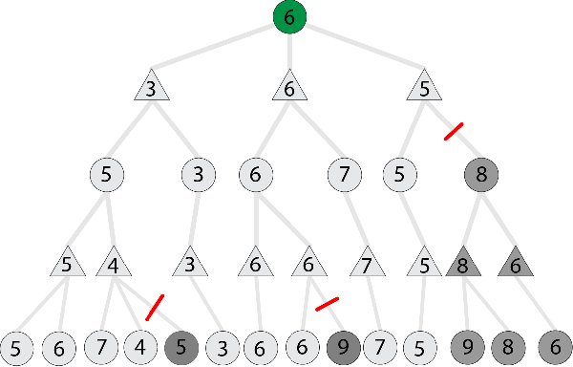
α-β pruning: example 3 α Pruning node>= β β Pruning node<= α

Slide 87
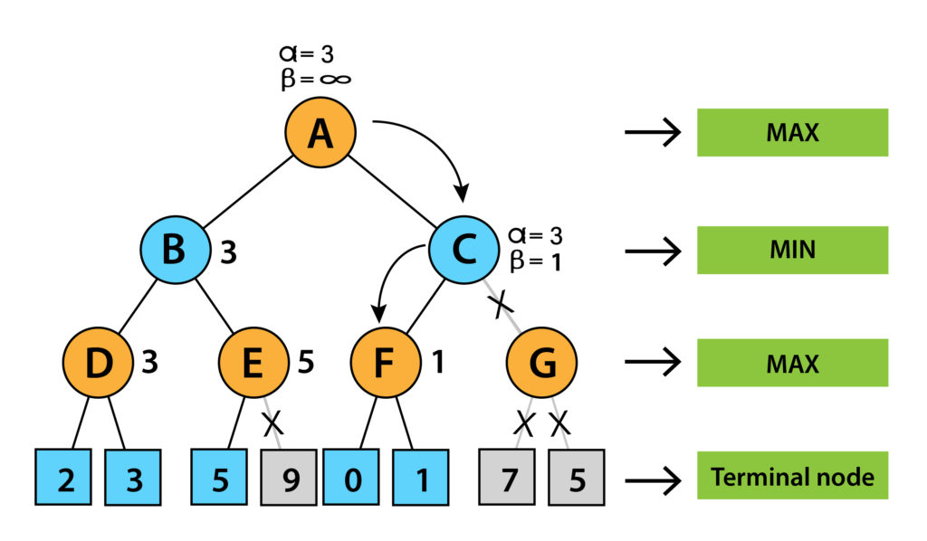
α-β pruning: example 3 α Pruning node>= β β Pruning node<= α

